Slide 1
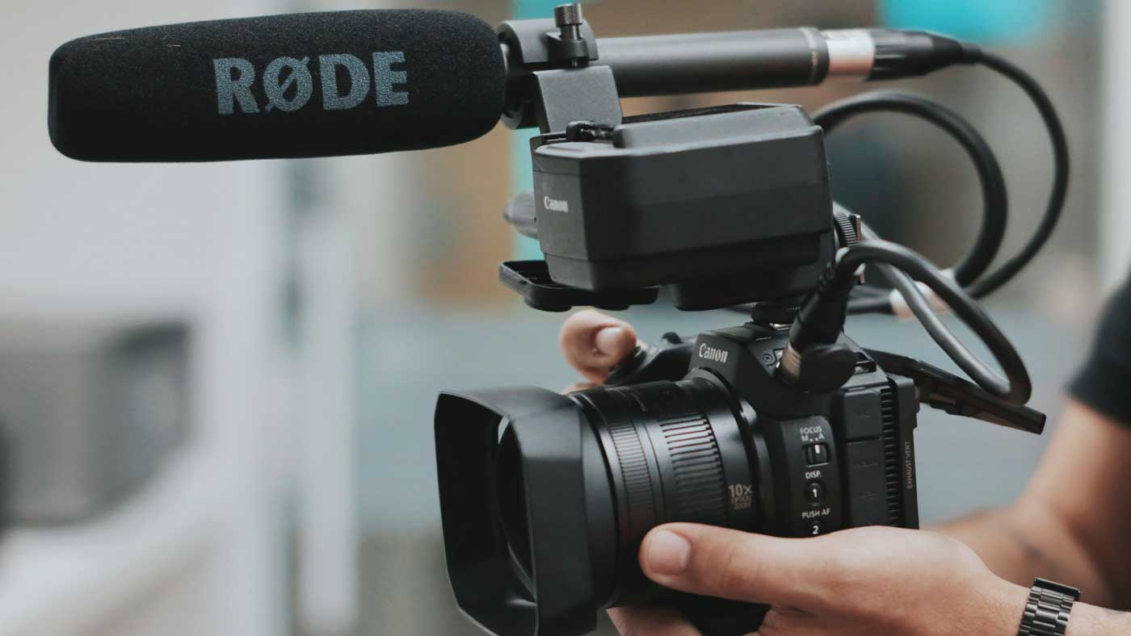
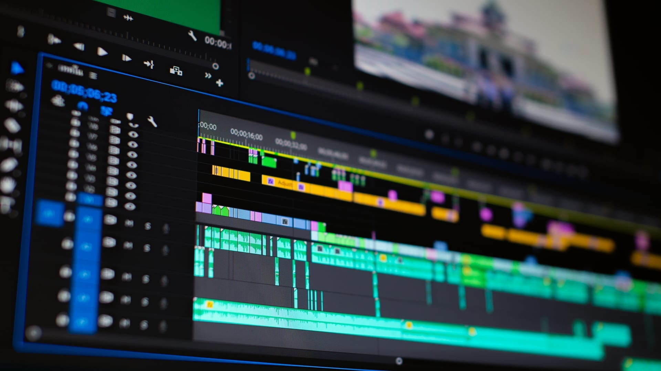
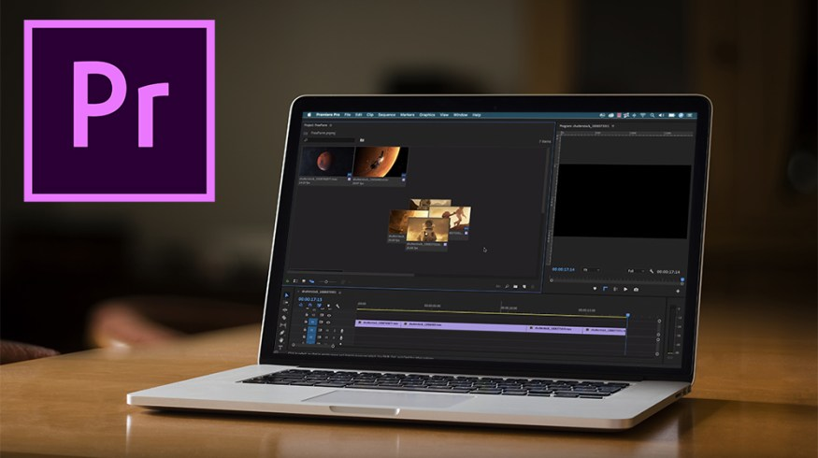
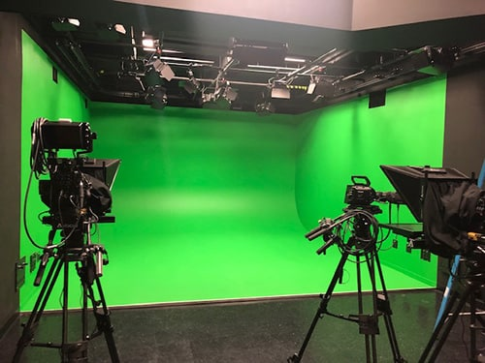

Slide 2
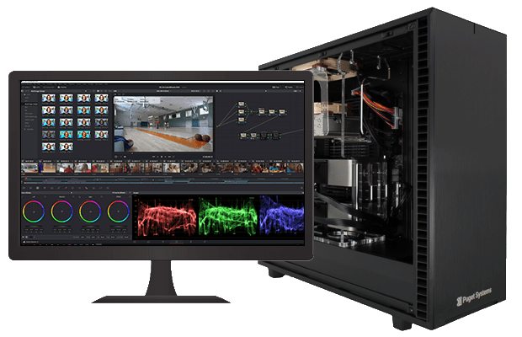
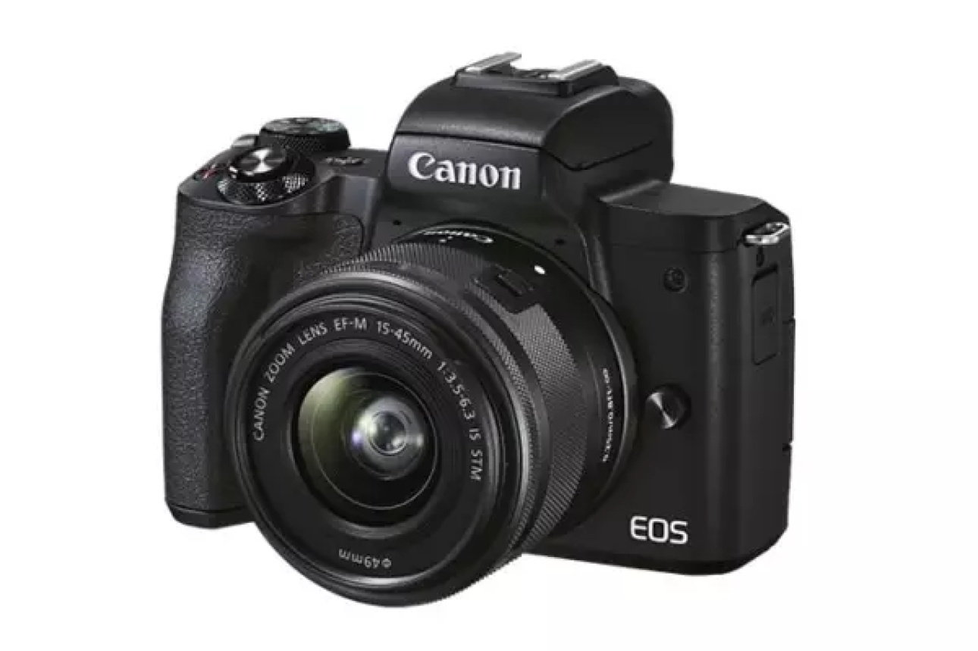
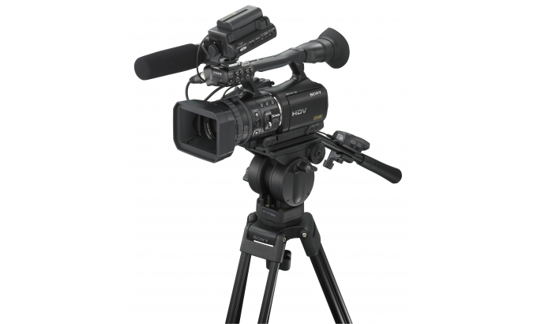
“Recording and Editing of Video Resources’’

Slide 3
This Session : Includes
Concept of the basics of Video Recording
Equipment required for Video Recording
Other Requirements
Process of Video Recording
Understanding basic Video Editing Techniques

Slide 4

Benefits of Video Resources in Education
It is a visual medium.
Video is more engaging.
Viewers/Learners can see and hear the information in a more attentive and dynamic way.
Viewers/Learners learn quickly and easily understand all the information delivered through video.
Retain their attention more.

Slide 5
Benefits of Video Resources in Education
Words are not required every time, some time Visuals speak itself.
A video is a powerful tool for teaching and learning.
Videos provide a way for learners to see and hear information more dynamically and engagingly than traditional text-based materials.

Slide 6
Benefits of Video Resources in Education
They can also help learners retain information more effectively.
Videos can enhance learning opportunities
Instructors /teachers can use videos to teach different types of subjects.

Slide 7
Benefits of Video Resources in Education
The use of videos in the classroom can have a significant impact on Student learning and Creativity. They can be a useful way to reinforce what you are teaching, particularly if the material is difficult to understand or if there is a lack of visual support.

Slide 8

Benefits of Video Resources in Education
Videos can be an effective way to improve student engagement and achievement in school. By using video clips in your classroom discussions and presentations, you can make the classroom a non-intimidating, fun learning space for all.

Slide 9
Video Production and Recording
The Process of video Production has three phases:
The first is Pre-production where we do all planning for development of video programme and produced a final script/ content for video recording.

Slide 10
After Pre-production the next main phases of production :
Production – Video Recording and Shooting Part.
Post Production – Rough editing and Final Editing to get an end product final Video.

Slide 11
Video Production Team
Production Team: Producer, Director and other
Technical Team
Camera Team
Editing Team
Graphic Team
Studio floor team
Set Designer
Makeup team

Slide 12
Video Recording
video recording is a recording of both the visual and audible components (especially one containing a recording of a movie or television program).
वीडियो एक दृश्य -श्राव्य माध्यम का प्रकार है जिससे विभिन्न प्रारूप में छोटे या बड़े चलचित्र का निर्माण किया जाता है। तस्वीरों को क्रम में दिखाकर जीवंत दृश्य का आभास किया जाता है और दृश्य के साथ श्राव्य का भी मिश्रण किया जाता है।

Slide 13
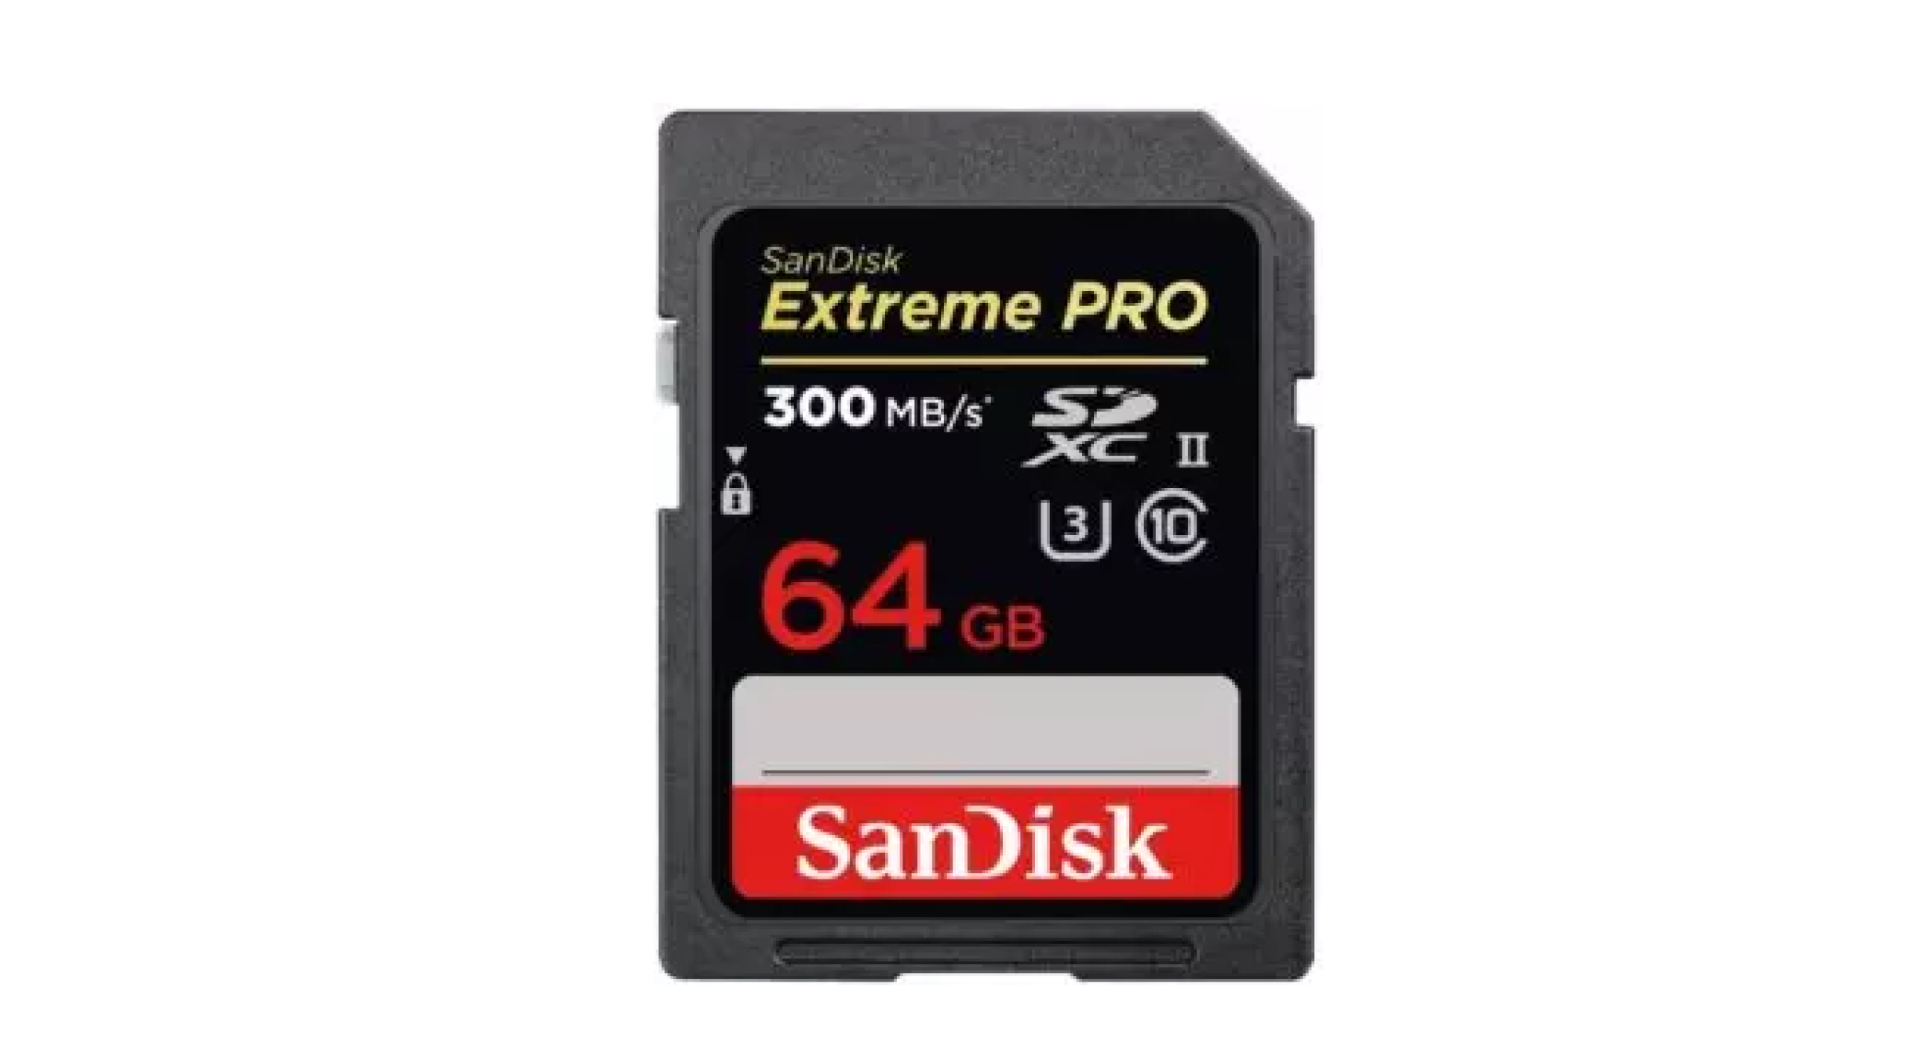
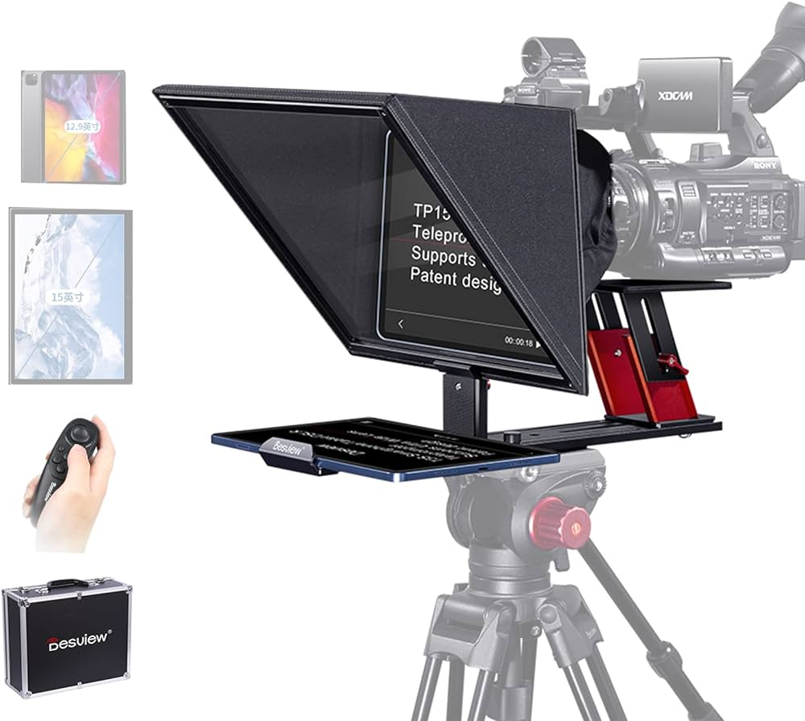
Basic Equipment Required for Video Recording
Video Camera– Digital Camera, P2, PTZ, DSLR and Smart Phone.
Tripod or Camera Stand.
Camera Batteries.
Camera Card – 64 GB/128 GB
Lights with Stands.
Mics (Cordless Microphones)
Teleprompter

Slide 14
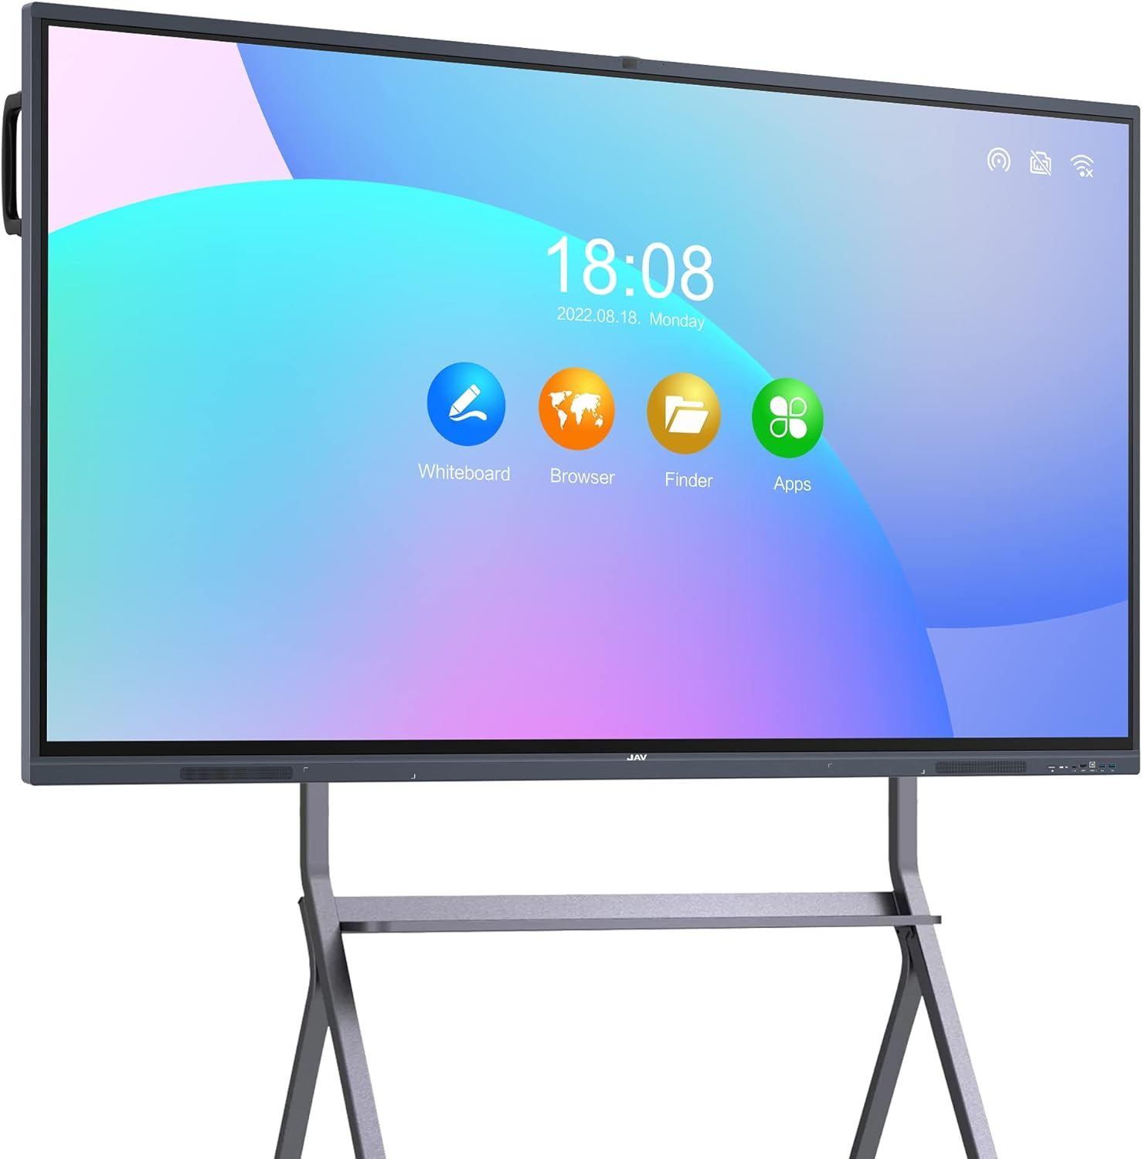
Basic Equipment Required for Video Recording
Laptop
Smart Board
Audio and Video Cable

Slide 15
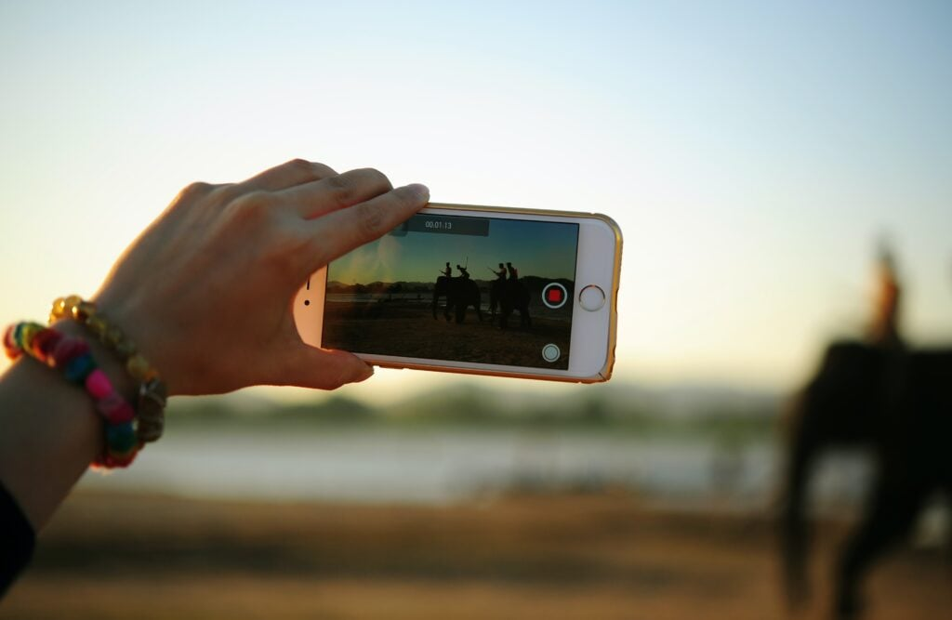
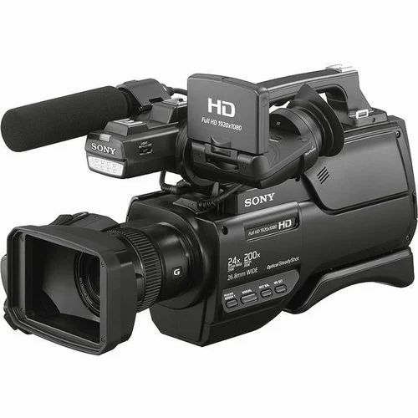
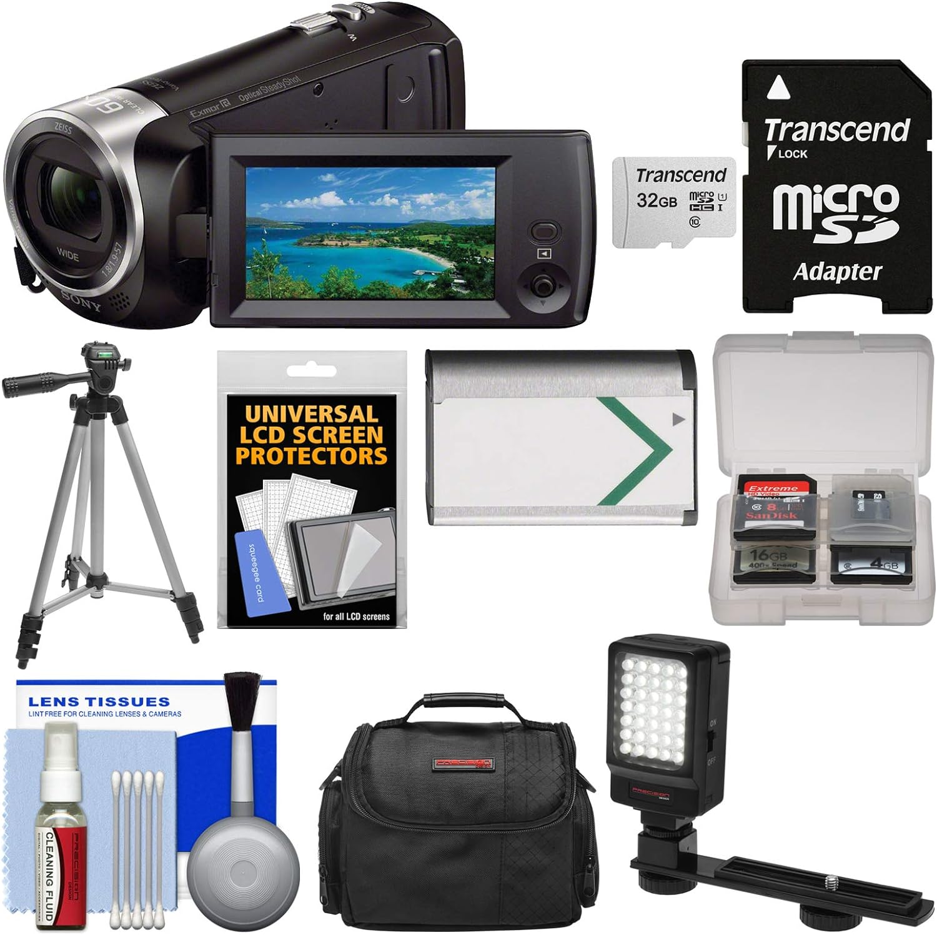
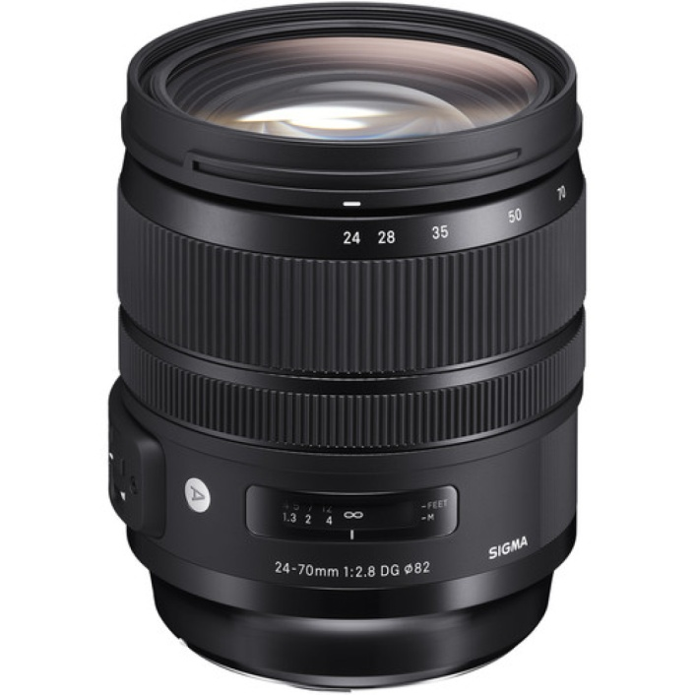
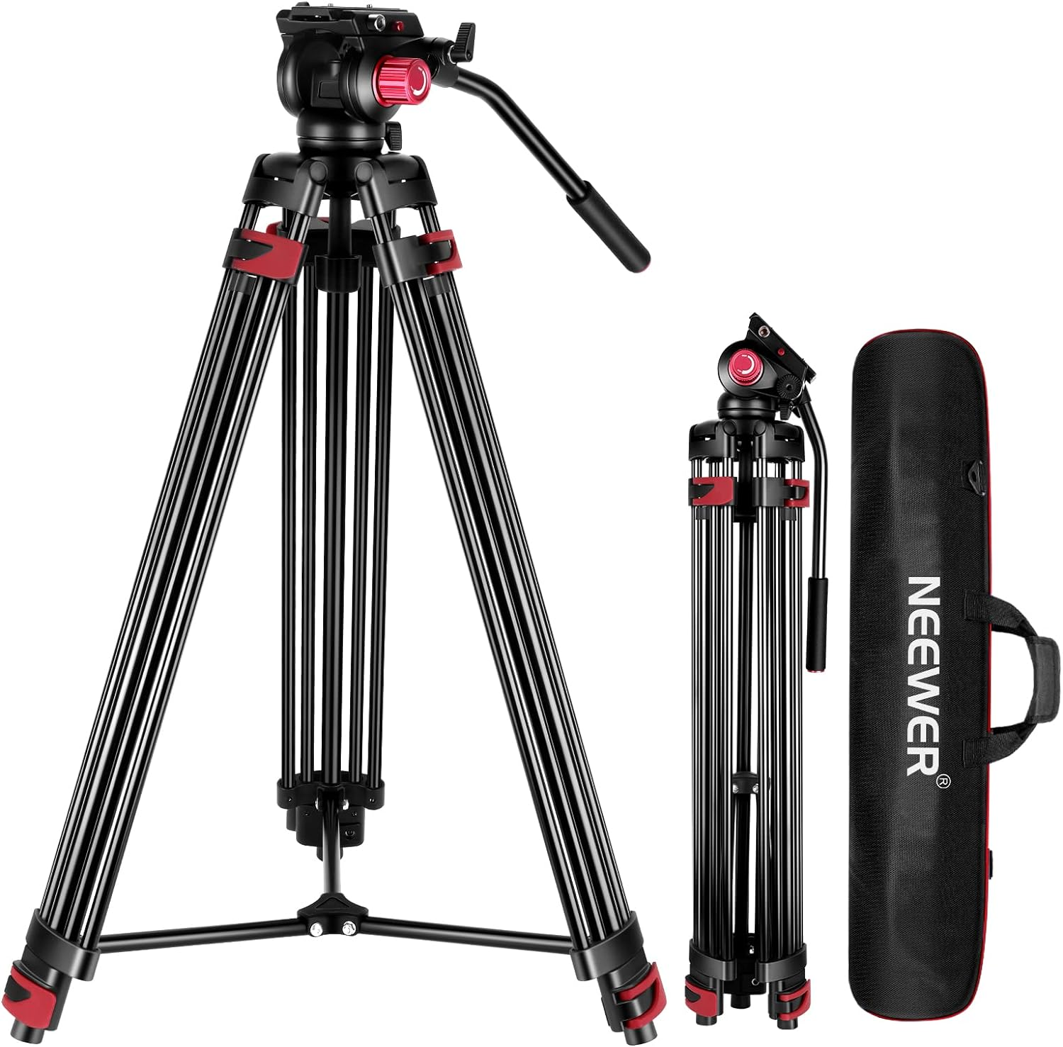
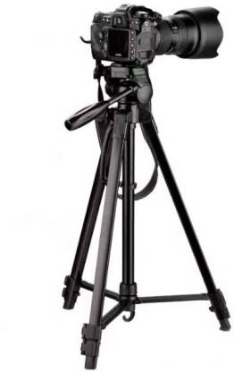
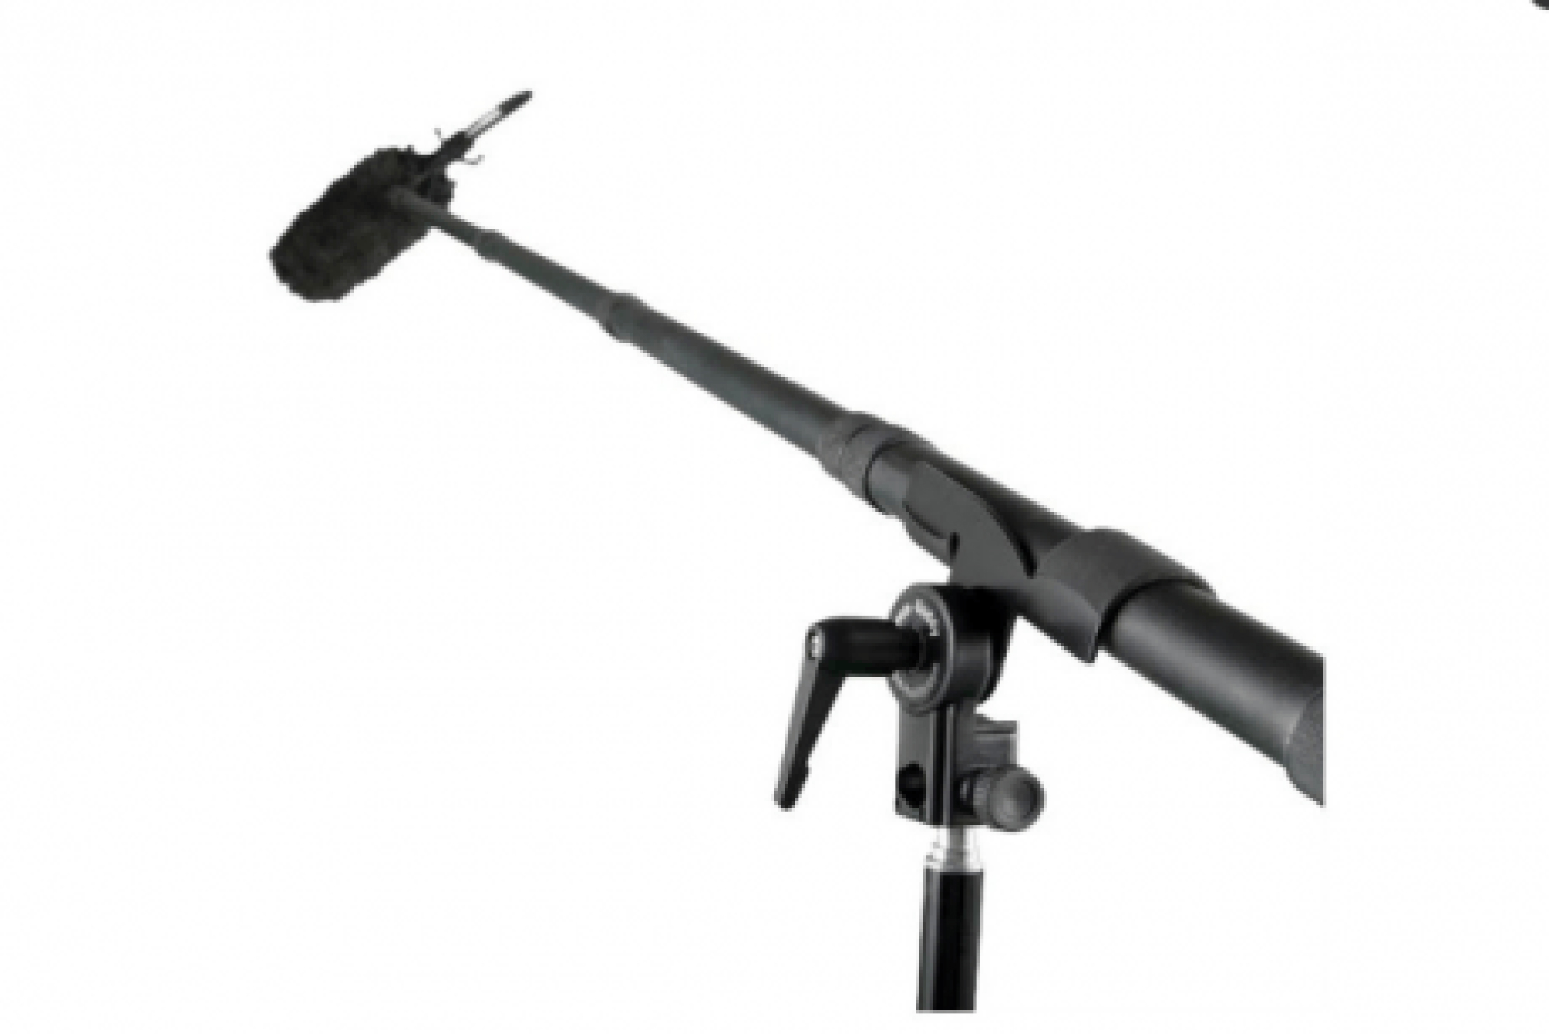
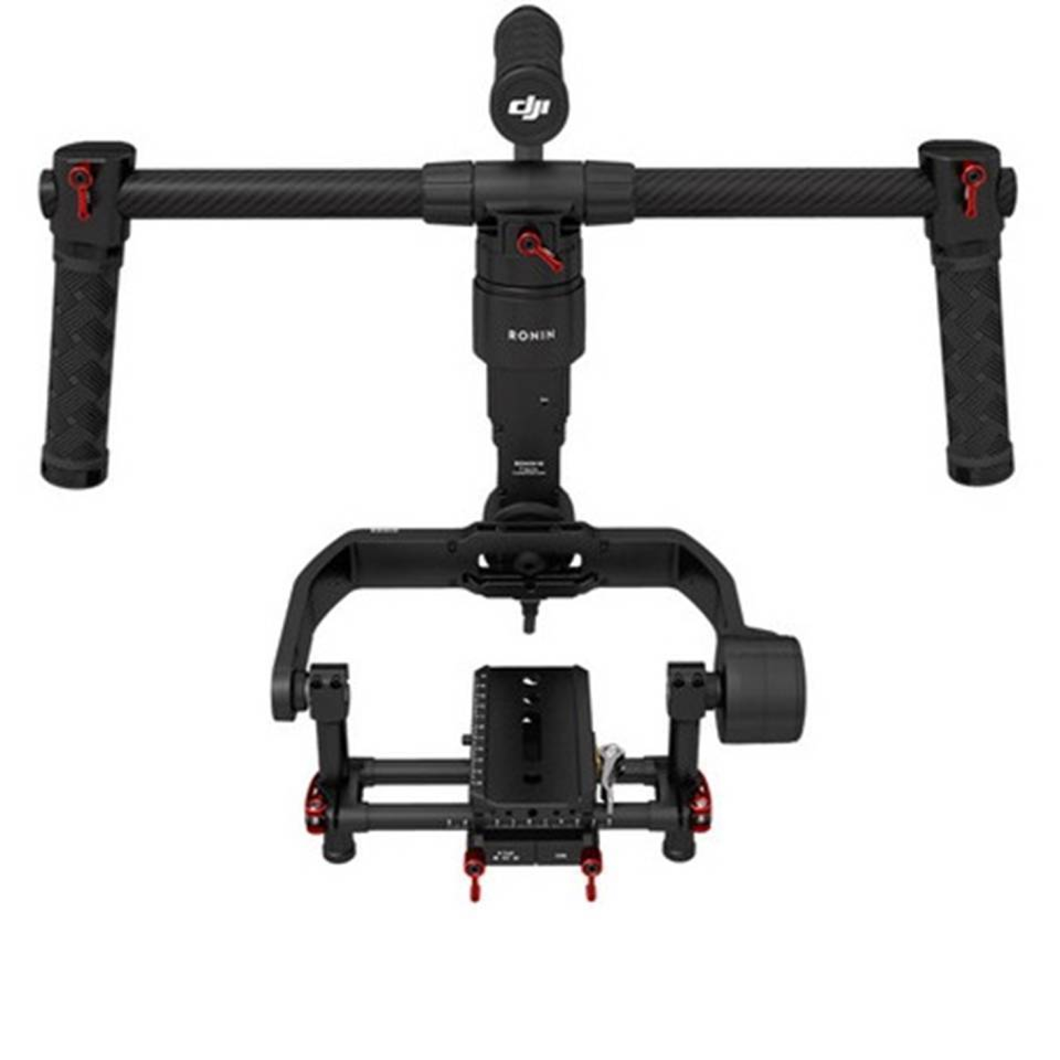
n

Slide 16
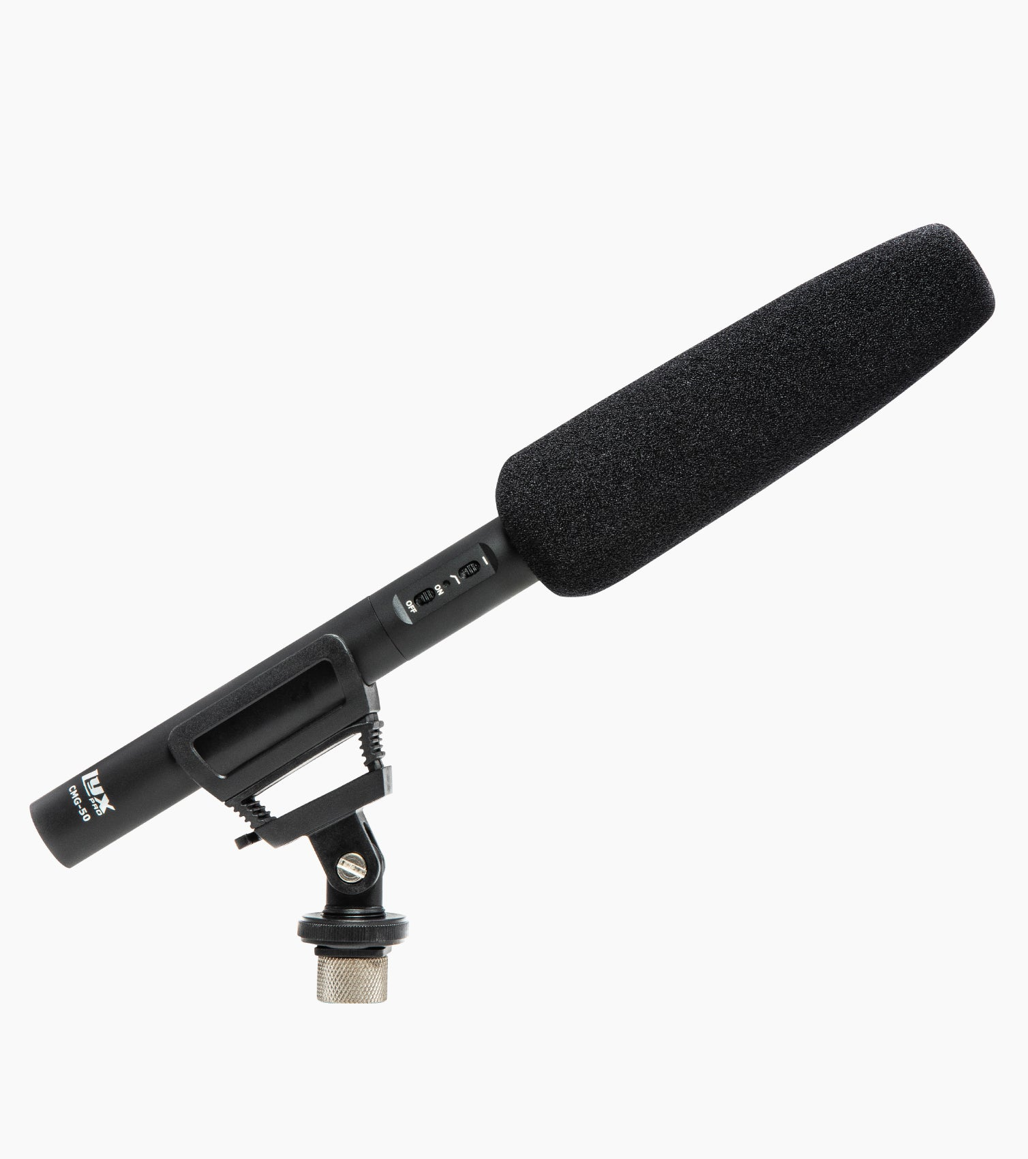
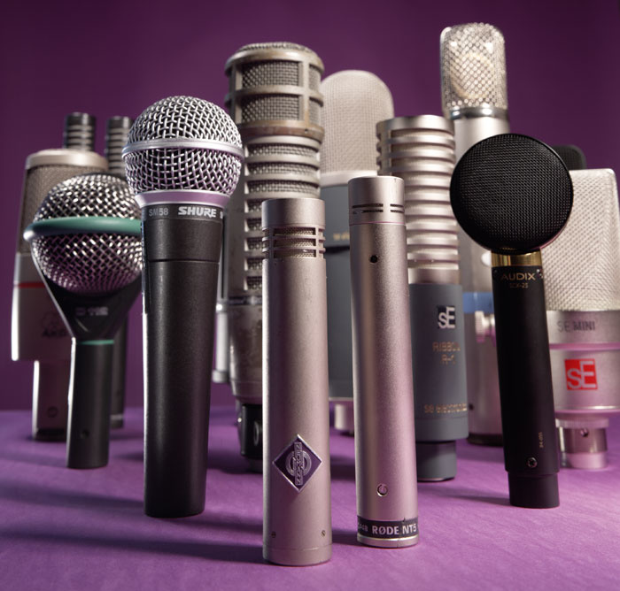
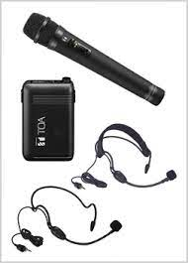
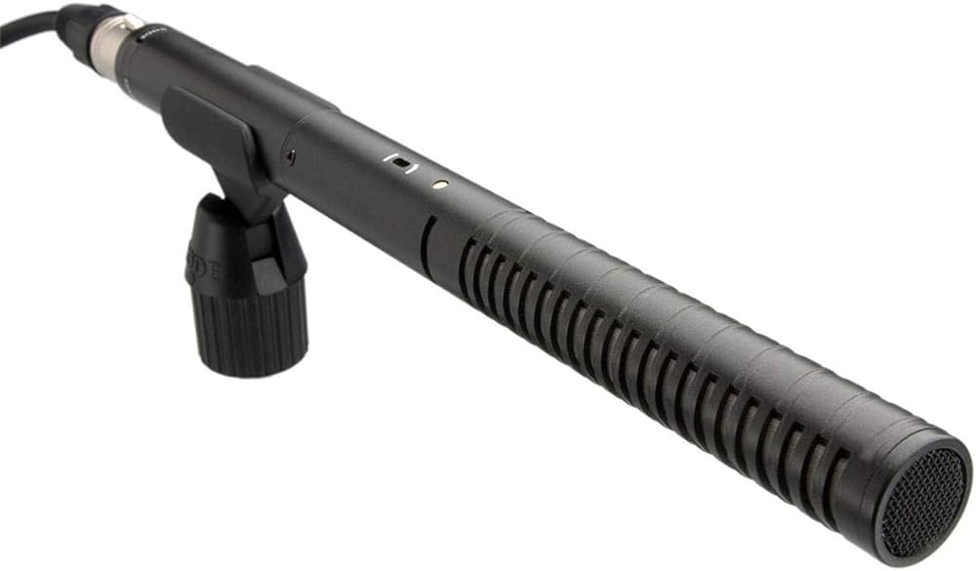
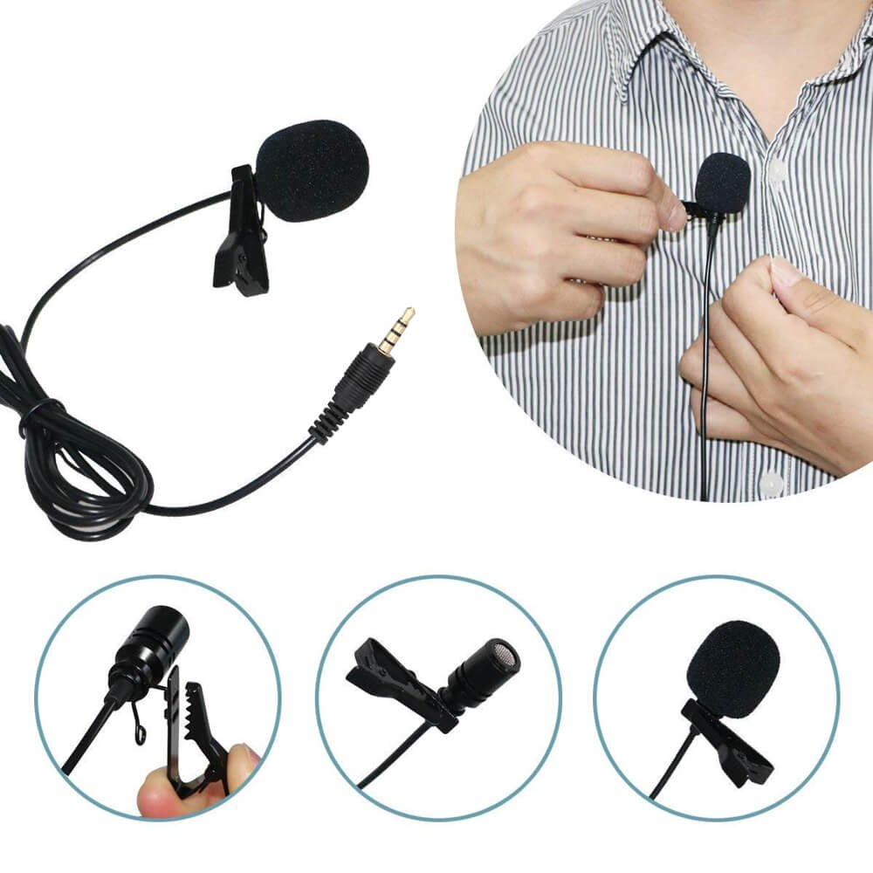
Microphones for Sound/Audio Recording

Slide 17
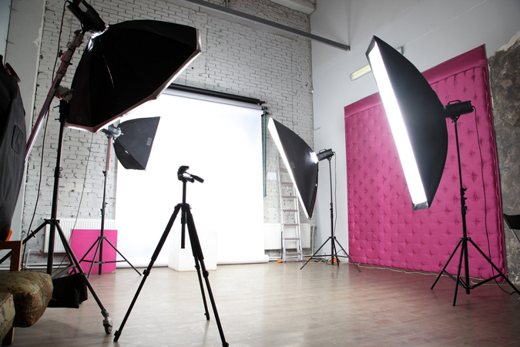
Lighting and Sound for Video Recording
Lights : Natural Light / Day Light Artificial light – Hot light (Tungsten/Halogen) Cool light (LEDs)

Slide 18
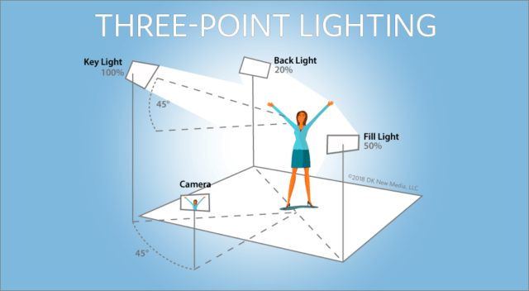
Basic Lighting Principle for Video Recording
Three Point Lighting –
Back Light,
Key Light
Fill Light.

Slide 19
Audio/Sound Recording
Managing Good Quality sound without noise and disturbance.
Use good quality Mics – Lapel, Cordless, Collar mic
Standard Audio Leve -12 to -6 dB
Audio and Video Cables : XLR, RCA, BNC, HDMI
Digital Cable – HDMI and SDI for Audio and Video

Slide 20
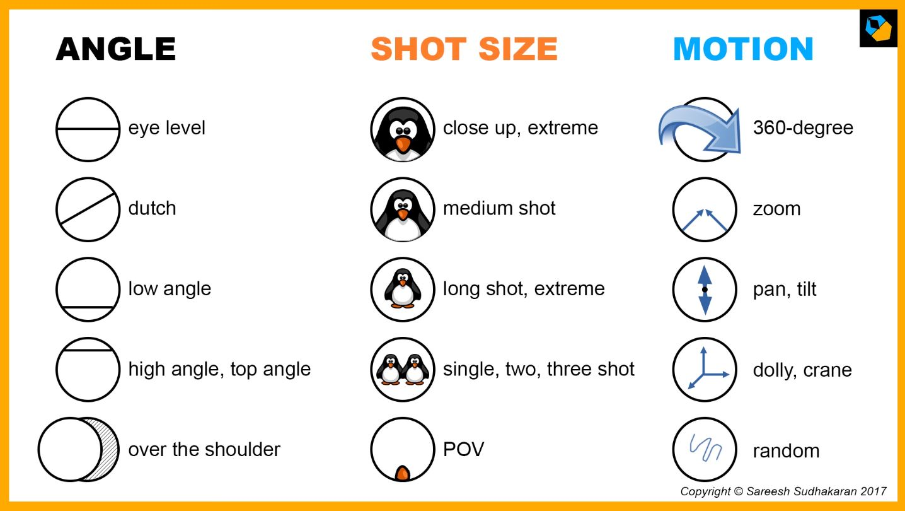
Camera Shots
Extreme Long Shot
Long Shot
MLS
MS
MCU
CU
ECU
Areal Shot

Slide 21
Camera Shots
Single Shot
Two Shot
Three Shot
Group Shot

Slide 22
Camera Movements
Pan – Right and Left
Tilt – Up and Down
Zoom – In and Out
Tracking
Dolly in and out
Crane Shot

Slide 23
Camera Angles
Wide Angle
Low Angle
High Angle
Over the Shoulder
Eye Level
Head Level

Slide 24
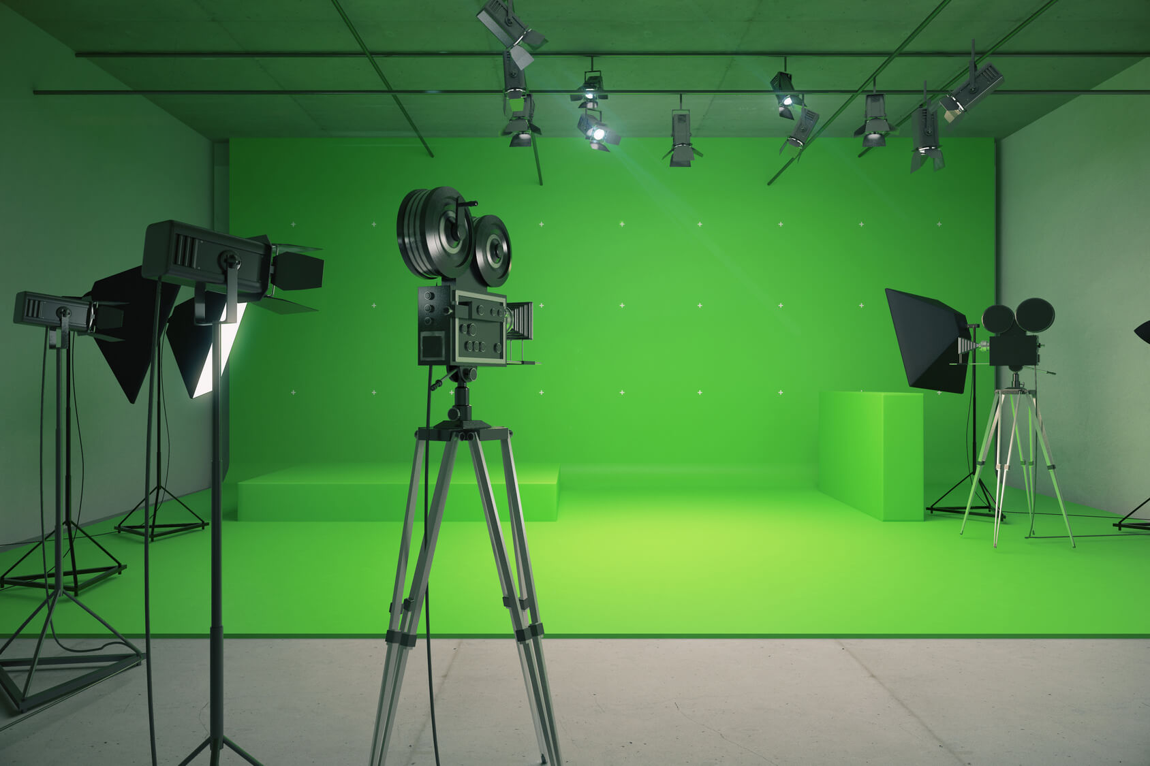
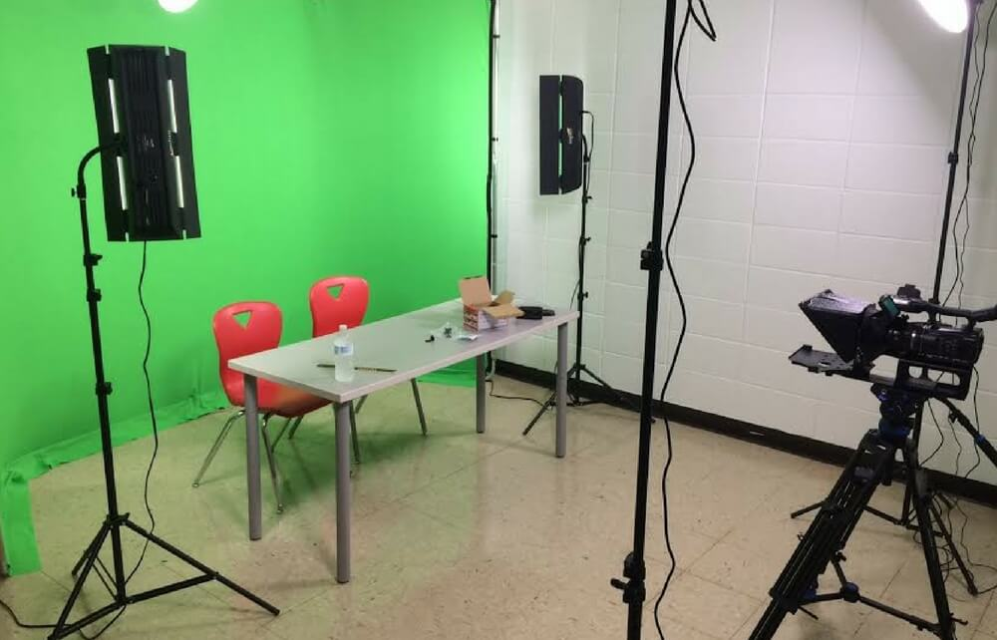
Other Essential Requirements for Video Recording
Studio (Soundproof)
Chroma Wall – Green Color Cloth, Blue Color Cloth
Avoid – Red Color Chroma Wall
Studio Set (As per requirement)
Table, Chair, Monitor (Screen)

Slide 25
Recording Studio

Slide 26
Others requirements for video recording
Filters
Lighting Gel
Butter Paper
Cutters
Reflector
Soundproof Recording Room with Acoustic treatment to control the noise and outside sound.

Slide 27
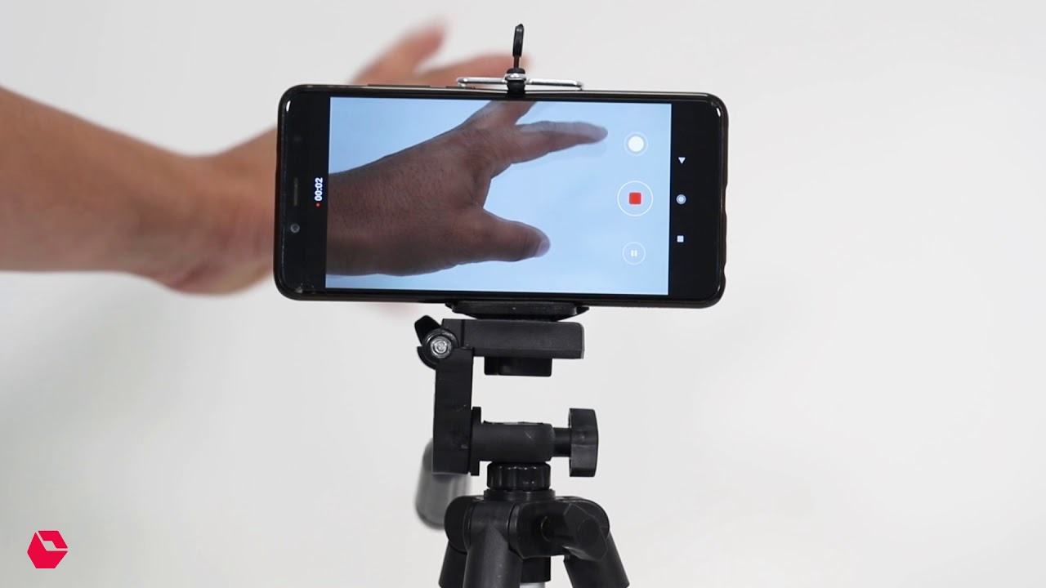
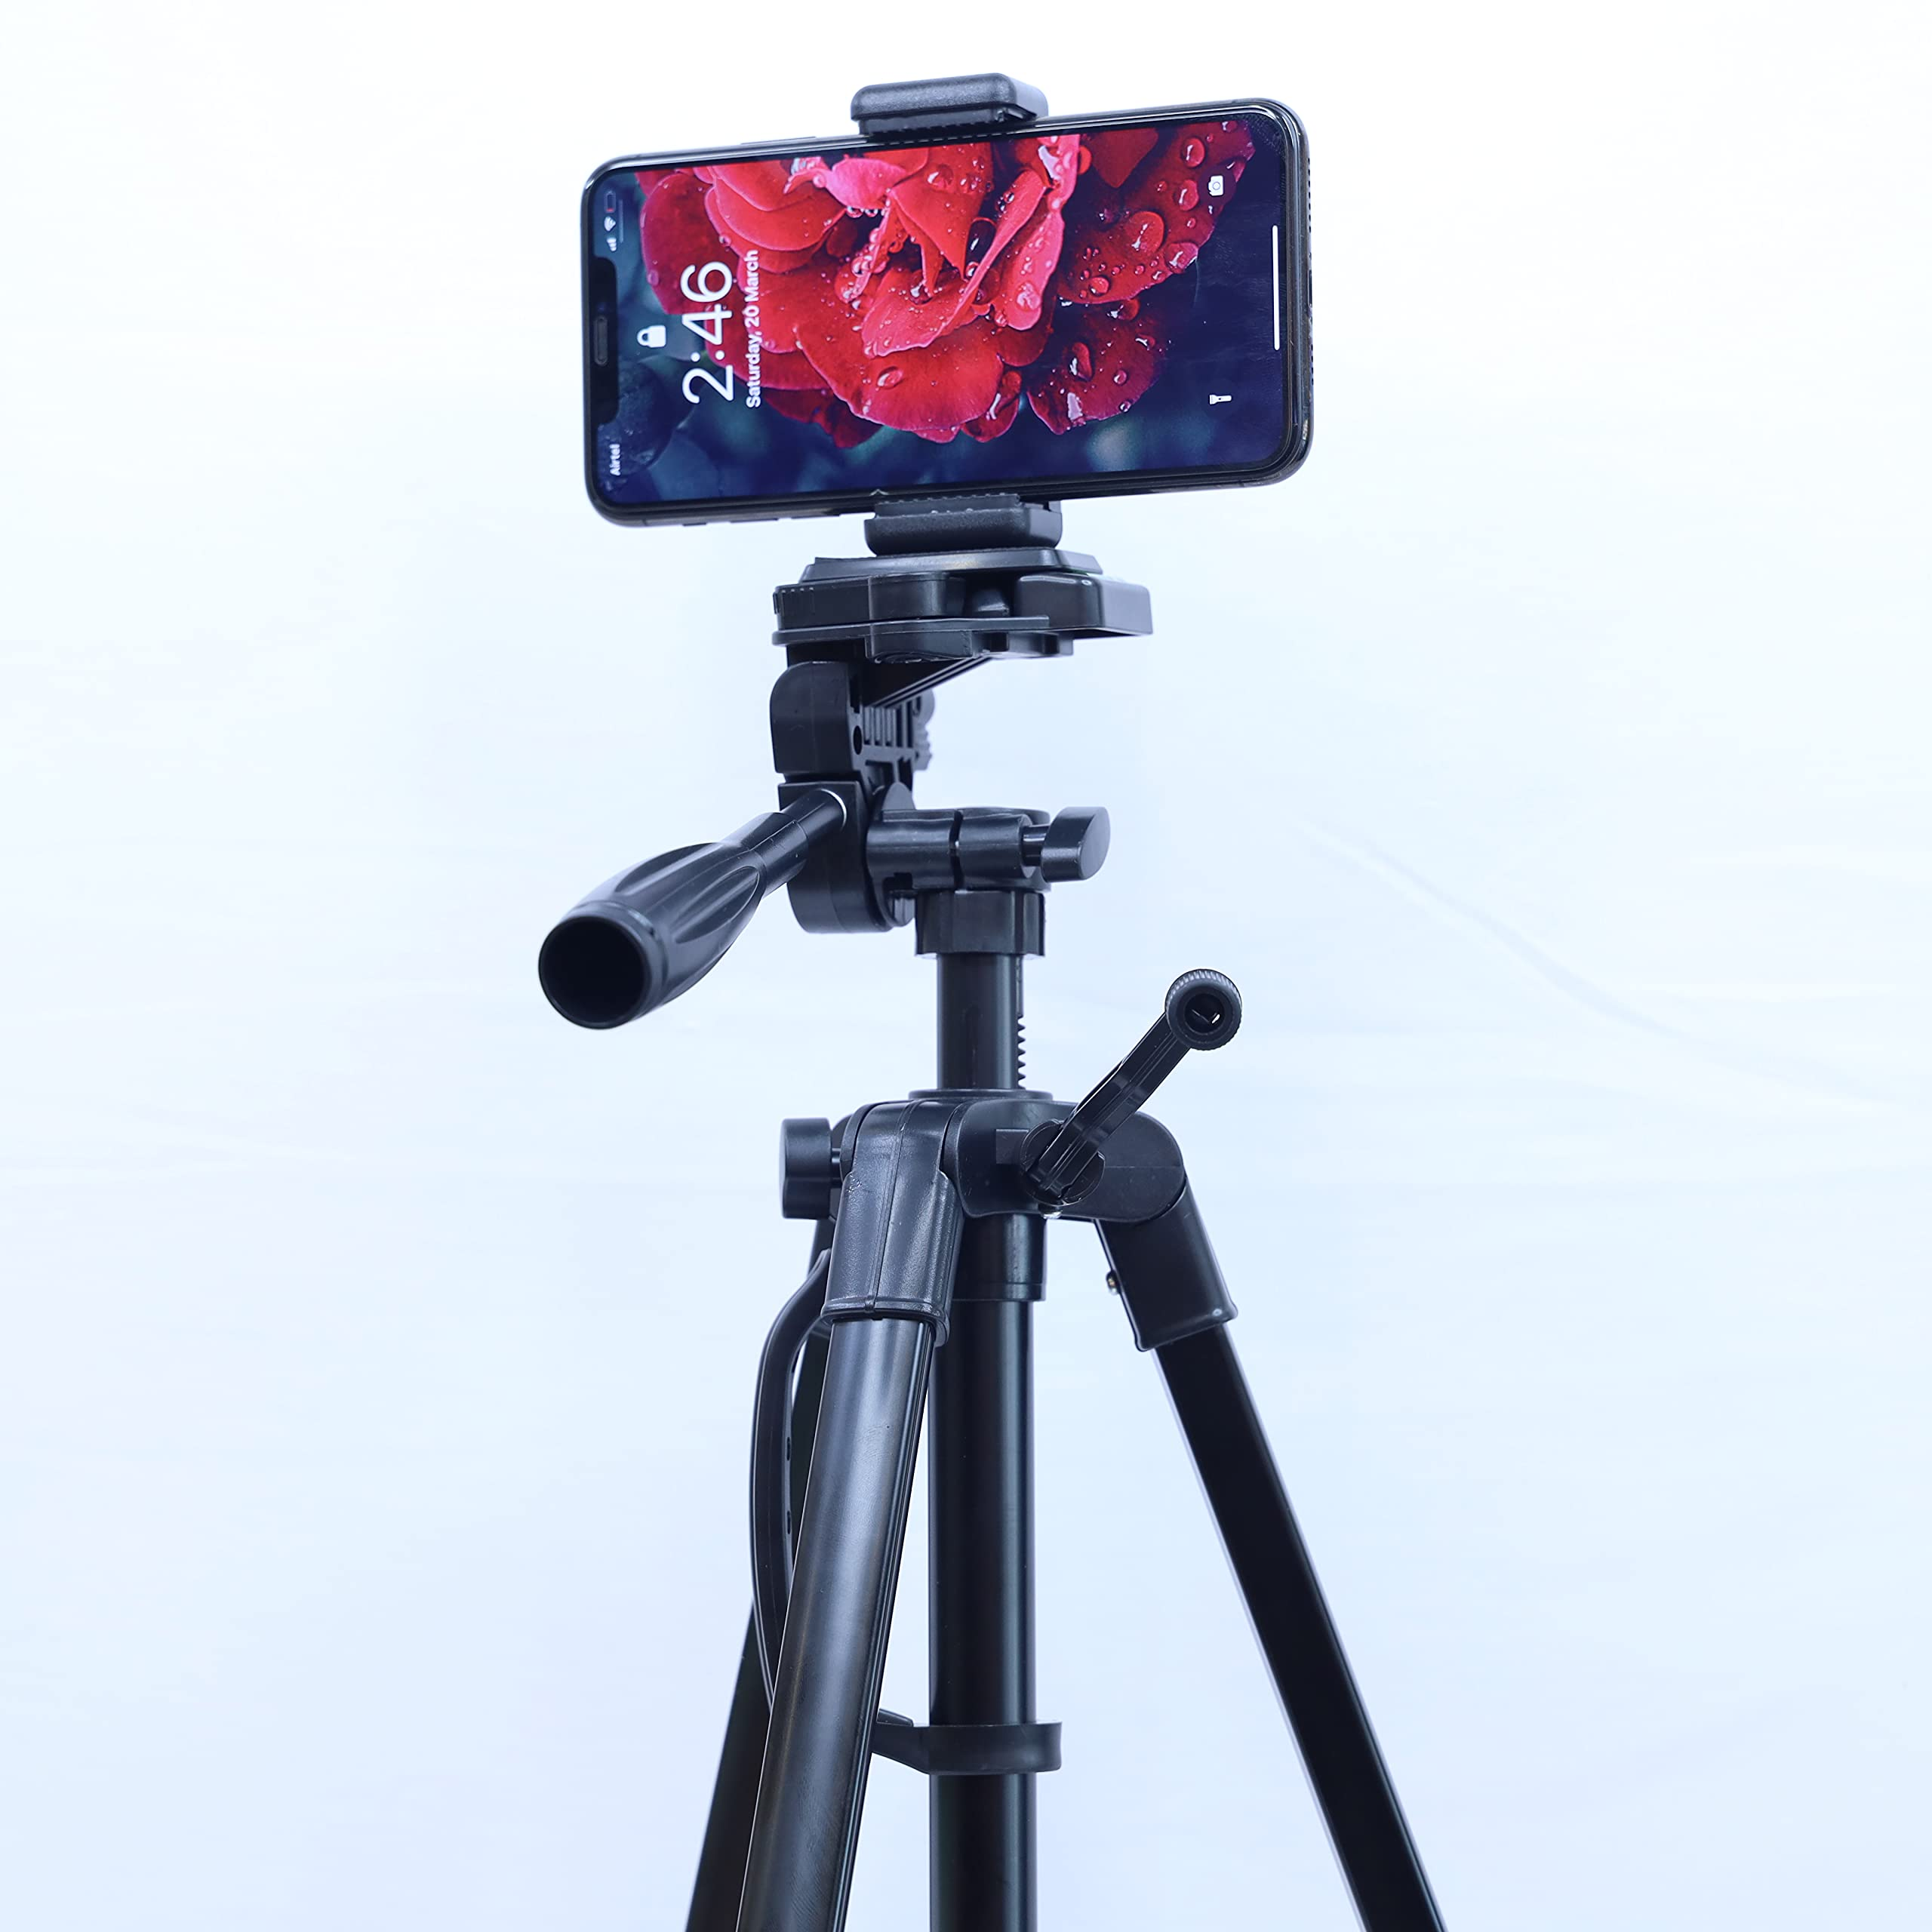


Recording of Video through Smart Phone
Mobile Camera
Stick/Stand to hold Mobile during recording.
Image Control
Mobile Placement Position.

Slide 28

Smartphone Mobile Recording
Camera features of a mobile camera standard
Image control
Light control
Resolution
Aspect Ratio
Frame orientation: Portrait (Vertical), Landscape (Horizontal)
Audio inbuilt and external audio source

Slide 29
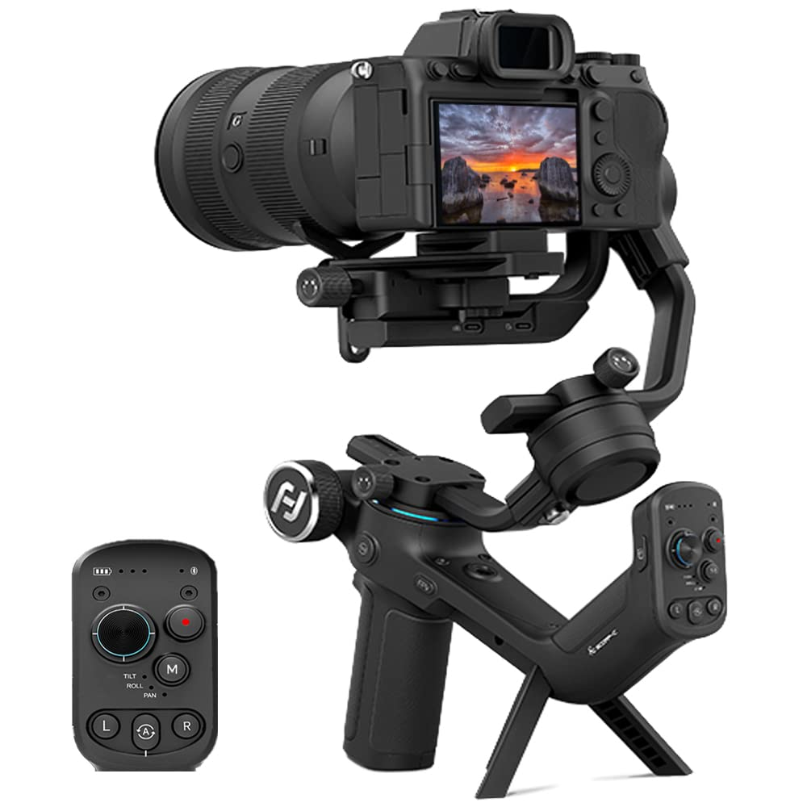
Gimbal (Video Camera)
Main reason to use a gimbal is to improve the quality and stability of your videos. A gimbal can eliminate shaky footage, unwanted vibrations, and jitters that can ruin your shots and make viewers dizzy.
For good quality of video
without any disturbance.

Slide 30
Formats of Video Recording Aspect Ratio
An aspect ratio is a proportional relationship between an image's width and height. Essentially, it describes an image's shape. Aspect ratios are written as a formula of width to height, like this: 3:2. For example, a square image has an aspect ratio of 1:1, since the height and width are the same.

Slide 31
Aspect Ratio
Aspect ratio is the proportional relationship between the width of a video image compared to its height. It is usually expressed as Width: Height (separated by a colon), such as 16:9 or 4:3. The aspect ratio sets how wide a video is formatted and affects how it will fit on your viewing screen.

Slide 32
Video Resolution
HD- High Definition refers to a video resolution with a higher pixel count than Standard Definition (SD).
HD videos have a minimum resolution of 1280x720 pixels, commonly known as 720p, but can also have a resolution of 1920x1080 pixels, also known as 1080p.
SD videos have a minimum resolution of 1280x720 pixels,

Slide 33

Video Resolution SD Vs HD
Difference b/w SD and HD Video in TV Screen

Slide 34
Backdrop
A backdrop is simply the background you use to record your videos. Backdrops help you create unique videos and break away from color-cluttered backgrounds and distracting objects in your shooting environment.
Backdrops are available in different sizes and styles, and there is no standardized type for general use.

Slide 35
Formats of Video File
MP4
MPEG4 also known MP4 it is most common widely accepted format
MOV
AVI
WMV
AVCHD
WebM
FLV

Slide 36
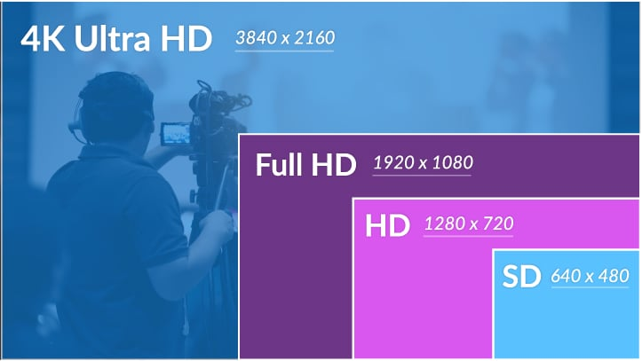

HD and SD Video

Slide 37
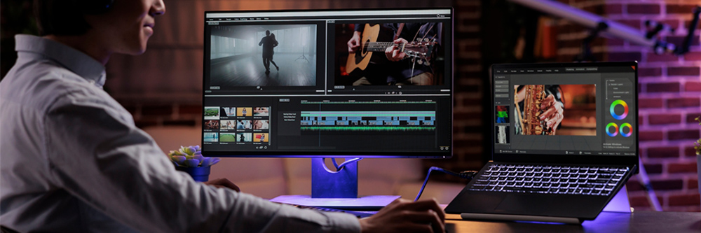

Slide 38
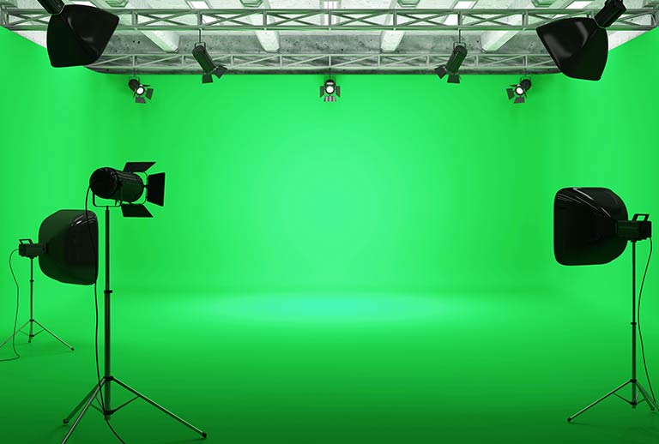
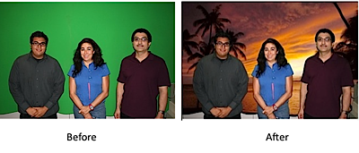
Chroma Key
Chroma key helps you to combine two different shots in the same frame. It replaces all the pixels with the defined green or blue key color with content from other film material or with digital content.

Slide 39
Chroma Wall in Studio

Slide 40
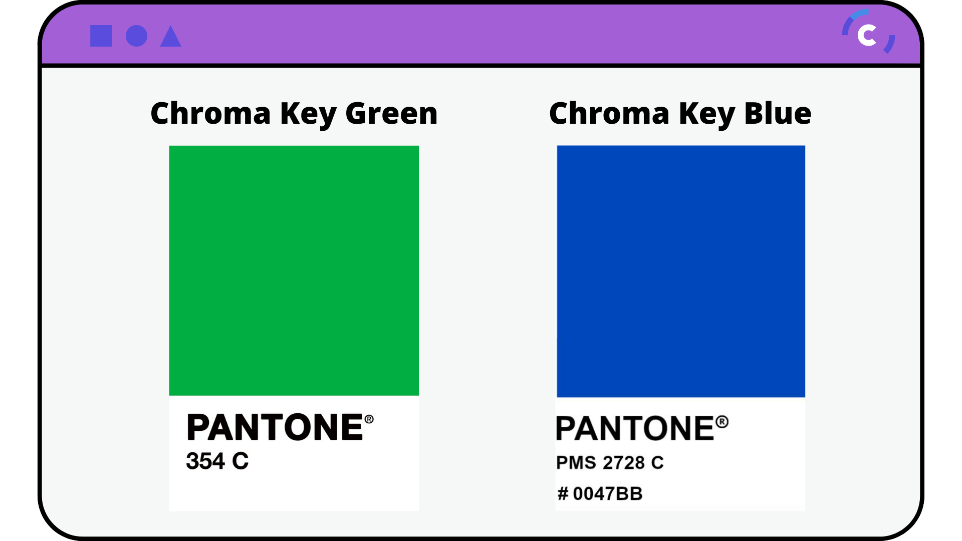
Chroma Screen Green and Blue

Slide 41
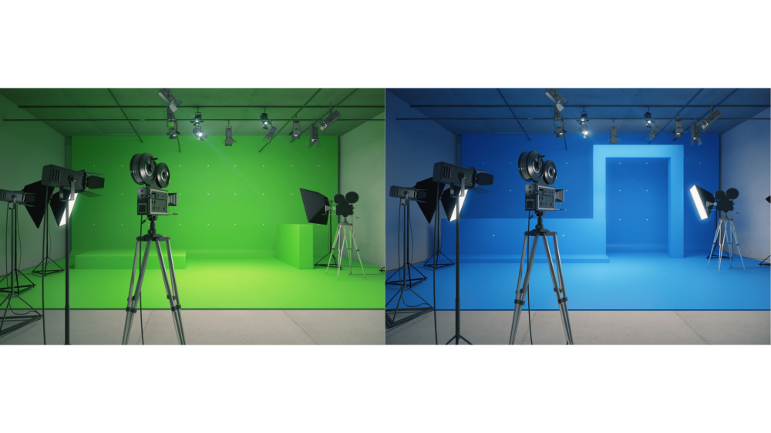

Slide 42
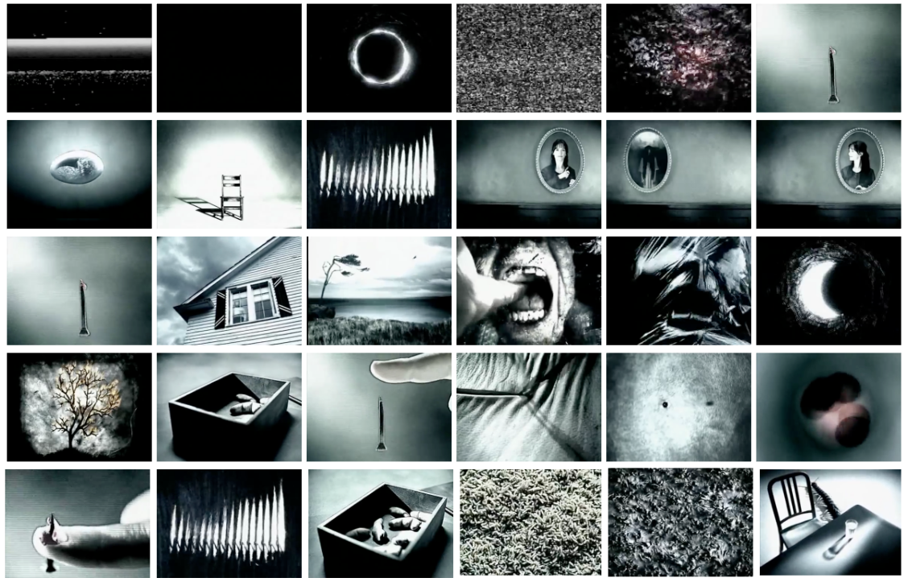
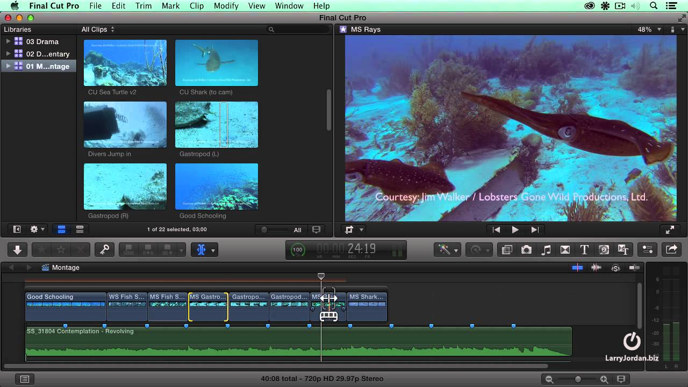
Montage

Slide 43
Video Montage
What is a video montage?
A montage video is a compilation of video clips and photos placed in a sequence to create a memorable video. A popular video technique in film making and on social media, montage videos are a powerful storytelling tool to convey a theme, narrative, and message.

Slide 44
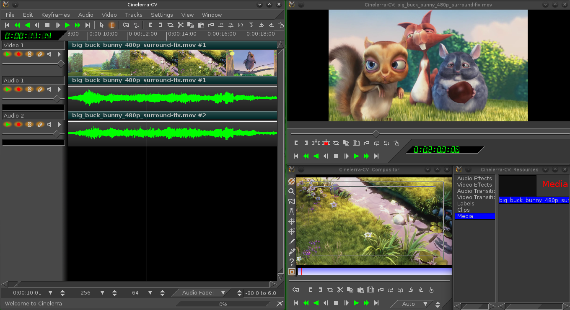
VIDEO EDITING

Slide 45
VIDEO EDITING
Post-production is the final stage of video creation. Once you've shot your footage, the finishing touches will need to be added to your film. The process can involve many individuals and teams, from sound mixers and voiceover artists to editors and colour graders.

Slide 46
Editing
As a film/video editor, you'll manage material such as camera footage, dialogue, sound effects, graphics and special effects to produce a final film or video product.
This is a key role in the post-production process and your skills can determine the quality and delivery of the finished result.

Slide 47
Film Editing and Video Editing
What Film Editing?
It is process of joinin g various shots of a Movie Production to create meaningful sequences and eventually bring a movie into life.
Without film editing, a movie would just be a collection of random visual sequences.

Slide 48
Film Editing and Video Editing
Video editing
Video editing is the post-production and arrangement of video shots.
Video editing includes cutting segments (trimming), re-sequencing clips, and adding transitions and other special effects.

Slide 49
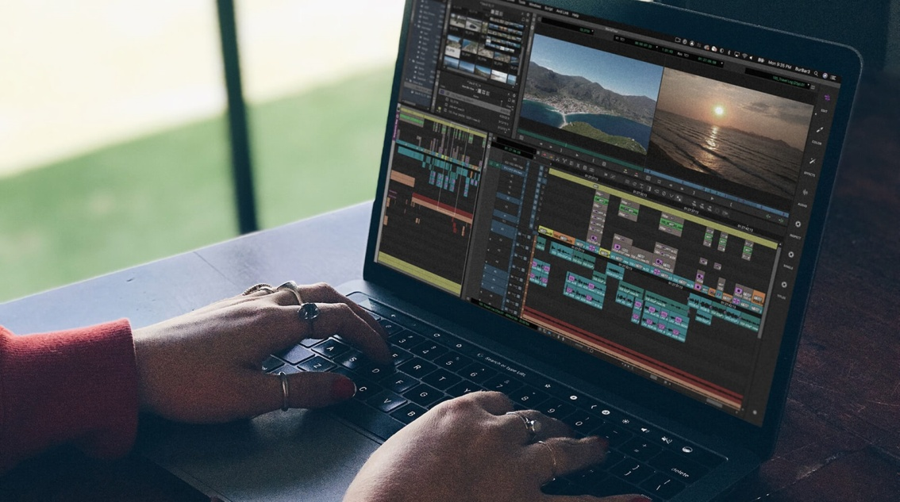
Video Editing
Video editing is the process of manipulating and rearranging video shots to create a new work. It is part of the post-production process.
It is process taking place after pre production. Like Planning Budgeting, Scripting, location,
Shooting/ Recording etc.

Slide 50
Types of Video Editing
Linear Editing- Linear editing is the process of editing either video or audio projects in a predetermined sequence from start to finish. You start editing the project at the beginning and finish at the end, with everything staying in order.
Tape to Tape editing.

Slide 51
Types of Video Editing
Non-linear video editing- Non-linear editing is a form of offline editing for audio, video, and image editing. In offline editing, the original content is not modified in the course of editing. In non-linear editing, edits are specified and modified by specialized software. NLE

Slide 52
Type of Shots used in Editing
Long Shot : The long shot, also known as the wide shot, is often times used as an establishing shot in a film, as it normally sets the scene and the character’s place within it. It is also know as “Master Shot”.
Medium Shot: A medium shot, or waist shot, indicates that it was captured at a medium distance from the subject.
Close-up: A close-up shot is a shot taken of a person or object at a close range, in order to capture the minute details of the subject.

Slide 53
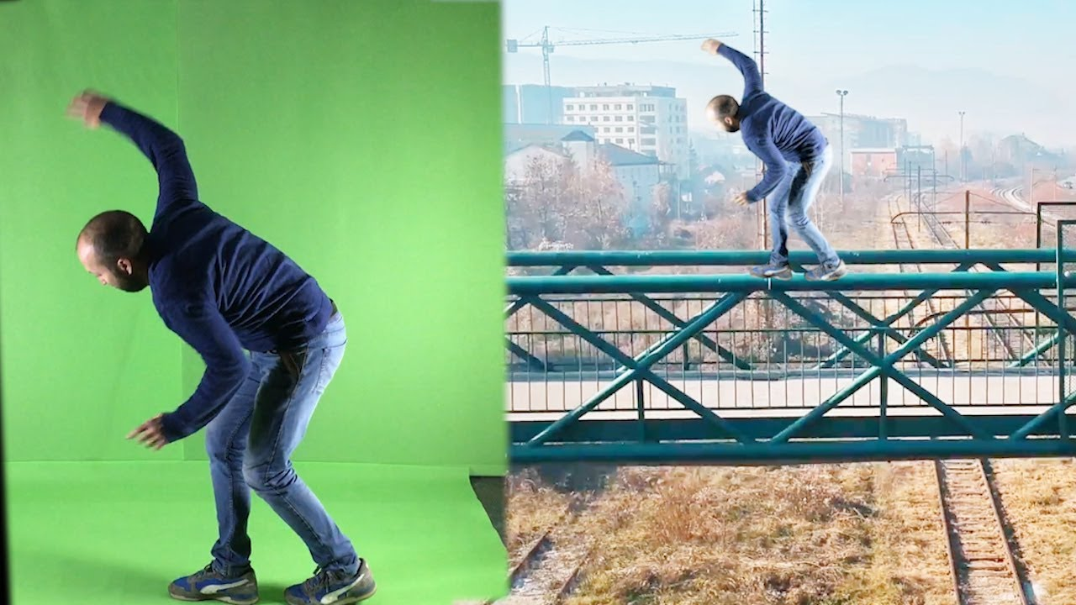
Chroma Key
The Chroma key technique is the process by which a specific color is removed from an image, allowing that portion of the image to be replaced.
This color can be any solid color, most commonly blue or green.

Slide 54
Types of Broadcasting signals
PAL (phase alternation line)- This is the video format standard used in many European countries. A PAL picture is made up of 625 interlaced lines and is displayed at a rate of 25 frames per second and a aspect ratio of 4:3. (PAL in India)
NTSC (National Television Standards Committee)-
It named for the group that originally developed the black & white and subsequently color television system that is used in the United States, Japan and many other countries. An NTSC picture is made up of 525 interlaced lines and is displayed at a rate of 29.97 frames per second and a aspect ration of 16:9.

Slide 55
Types of Broadcasting signals
Secam- SECAM is an abbreviation for Sequential Color and Memory. This video format is used in many Eastern countries such as the USSR, China, Pakistan, France, and a few others. Like PAL, a SECAM picture is also made up of 625 interlaced lines and is displayed at a rate of 25 frames per second. However, the way SECAM processes the color information, it is not compatible with the PAL video format standard

Slide 56
Types of Video Format
MP4 (Moving Picture Experts Group)-MP4 works well for videos posted on YouTube, Facebook, Twitter and Instagram.
MOV-MOV (QuickTime Film) stores high-quality video, audio and effects, but these files tend to be quite large. Developed for QuickTime Player by Apple,
AVI-AVI (Audio Video Interleave) works with nearly every web browser on Windows.

Slide 57
Types of Audio Format
MP3-MP3 is the most popular of the lossy formats.
AAC-Advanced Audio Coding or AAC files (also known as MPEG-4 AAC), take up very little space and are good for streaming,
WAV-WAV (Waveform Audio File) retains all the original data, which makes it the ideal format for sound engineers. “WAV has greater dynamic range and greater bit depth,”
AIFF- Audio Interchange File Format (AIFF) File format for sound that wraps various sound bits treams, ranging from uncompressed waveform

Slide 58
Types of Resolution
For the default 16:9 aspect ratio, encode at these resolutions:
7680p (8K): 7680x4320
2160p (4K): 3840x2160
1440p: 2560x1440
1080p: 1920x1080 (FHD)
720p: 1280x720 (HHD)
480p: 854x480
360p: 640x360
240p: 426x240

Slide 59
Types of Software - Editing
Paid Softwares
Adobe Premiere Pro
Final Cut Pro
Avid
Edius

Slide 60
Types of Software
Free Softwares
Windows Movie Maker
Openshot Video Editor
iMovies
Movie AVI Video Editor

Slide 61

OpenShot Video Editor
OpenShot Video Editor is a free and open-source video editing software for Windows, macOS, Linux, and Chrome OS.
It is a free, and friendly to use video editor.

Slide 62
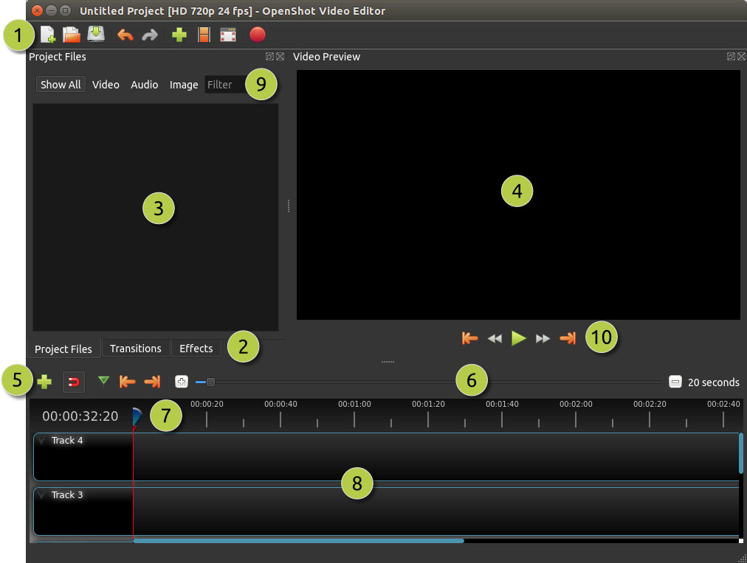
Interface
1. MainToolbar
2. Edit Toolbar
3. Project Files
4. Preview Window
5. +
6. Zoom Slider

Slide 63
7. Playhead
8. Timeline
9. Filter
10. Playback

Slide 64
Basics of Adobe premiere Pro
There are five basic things you should know
how to do in Premiere Pro.
  Import footage.
  Create a sequence.
  Add a title.
  Add and adjust audio.
  Export.

Slide 65
Transitions in Adobe premiere pro
A transition is the way one shot changes to the next. By default, if two clips are placed next to each other in the timeline, the transition is a cut. To make more interesting transitions such as dissolves, wipes and effects, use the transitions available in the Effects window.

Slide 66
Editing
Film editing is a crucial part of the filmmaking process, and there are several types of editing cuts used to create a seamless and engaging visual narrative.
Here are some common types of editing cuts in film:

Slide 67
Editing
Cut: The most basic type of editing cut. It involves a direct transition from one shot to another, often used to show a change in time, location, or perspective.
Fade and Dissolve: Fades are used to gradually transition from or to black or white. Dissolves involve overlapping two shots, making one image fade out while the other fades in. These cuts are often used to indicate a change in time or location, or to create a dreamy, poetic effect.
Wipe: A transition where one shot replaces another by sliding, wiping, or spinning across the screen. It's a less common technique and often used for stylistic purposes.

Slide 68
Editing
Cut-In: A cut to a closer shot within the same scene or action to highlight a specific detail, often used to show a character's reaction or draw the audience's attention to something significant.
Cutaway: A cut to a shot that is unrelated to the current action, usually a brief shot of an object, person, or location, used for context or to emphasize a point.

Slide 69
L-Cut(video lead in) and J-Cut(audio lead in): In an L-cut, the audio from the previous scene continues into the next scene while the visuals change. In a J-cut, the audio from the next scene starts before the corresponding visuals appear. These techniques can create a smooth transition between scenes and enhance the flow of the film.

Slide 70
Editing
Cross-Cut (Parallel Editing): Cross-cutting is used to show simultaneous actions or events occurring in different locations. It cuts between two or more storylines to build tension and show the relationship between them.
Montage: A sequence of shots edited together to condense time, convey information, or create an emotional impact. Montages are often used to show the passage of time or a character's personal growth.

Slide 71
Editing
Jump Cut: A cut within the same shot that creates a jarring effect by skipping part of the action, resulting in a noticeable discontinuity. Jump cuts are often used for stylistic or dramatic purposes.
Match Cut: This is a type of cut that connects two shots by matching elements in both shots. For example, a character might be shown reaching for a doorknob in one shot, and in the next shot, the doorknob they are turning might match the position of their hand.

Slide 72
Editing
These are some of the fundamental editing cuts in filmmaking, and skilled editors use these techniques in creative ways to shape the narrative and engage the audience.

Slide 73
video recording. a recording of both the visual and audible components (especially one containing a recording of a movie or television program)

Slide 74
So, Video recording is a way of storing television programs and other moving images along with sound. Video recording is used to record TV programs for later broadcast. Video recording also gives viewers the ability to save a TV program and watch it whenever they want to.

Slide 75
Thank you

